Slide 1


Khaled Ahmed
03/06/2022

Slide 2

Outline
Executive Summary
Introduction
Methodology
Results
Conclusion
Appendix

Slide 3
Executive Summary
Summary of methodologies
Data Collection using SpaceX API and Web Scaping (Wikipedia)
Data Wrangling using Pandas
Exploratory Data Analysis (EDA) with SQL, and Visualization (Pandas and Matplotlib)
Interactive Visual Analytics and Dashboard with Folium and Plotly Dash
Machine Learning Prediction by Predictive Analysis (Classification) using NumPy and Scikit Learn
Summary of all results
Data collection is possible using SpaceX API and Wikipedia
Missing data was identified using Data Wrangling
Best features to predict success launches were identified using EDA
Visual Analytics and Dashboard showed proximity and success rate of launches by sites and payload
Machine Learning helped select the best Classification model to predict success and failure

Slide 4
Introduction
The objective is to take the role of a data scientist for a new rocket company, Space Y, that would like to compete with SpaceX
Desirable answers
Determine the price of each launch by gathering information about SpaceX and creating analytics dashboard for the team as the best way to estimate the total cost for launches is by predicting the successful landings of the first stage of rockets
Determine if SpaceX will reuse the first stage using machine learning model and public information

Slide 5

Section 1

Slide 6
Methodology
Executive Summary
Data Collection
How data was collected is described
Data Wrangling
How data was processed is described
Exploratory data analysis (EDA) is performed using visualization and SQL
Interactive visual analytics is performed using Folium and Plotly Dash
Predictive analysis is performed using classification models
How to build, tune, evaluate classification models is described

Slide 7
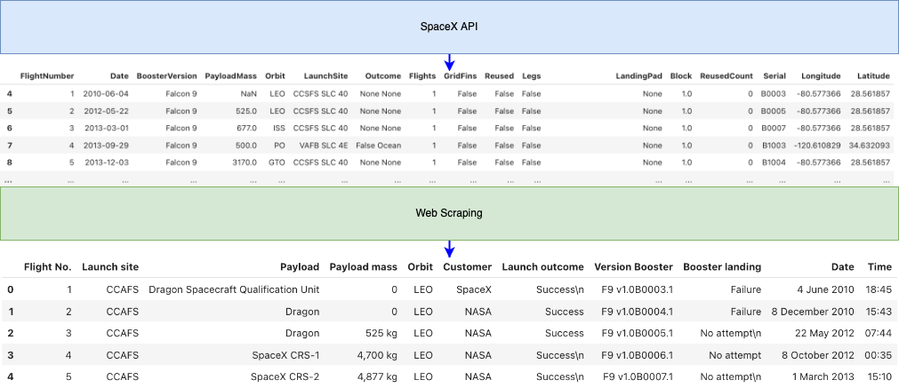
Data Collection
The datasets were collected using;
SpaceX API (https://api.spacexdata.com/v4)
Web Scaping from Wikipedia (https://en.wikipedia.org/wiki/List_of_Falcon\_9\_and_Falcon_Heavy_launches)

Slide 8
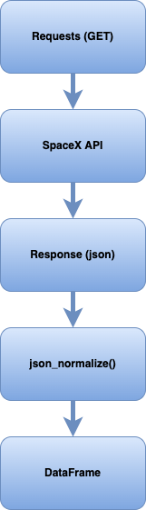
Data Collection – SpaceX API
Data was collected by a GET API call to the SpaceX API, and the response was converted to json format, which (json) was normalized to a DataFrame using json_normalize()
Self-defined helper functions were used to populate and normalize only the relevant columns and data
Only data for ‘Falcon 9’ was taken and the missing data was handled
Source Code:
https://github.com/khhaledahmaad/IBM-Data-Science-Professional-Certificate/blob/14bd495b945037a64f8381ac41d98005c7696b01/Applied%20Data%20Science%20Capstone/week1/Collecting%20the%20Data/jupyter-labs-spacex-data-collection-api.ipynb

Slide 9
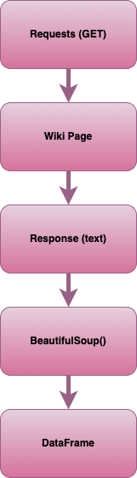
Data Collection – Web Scraping
Data was collected by a GET API call to the Wikipedia Page, and the response was converted to text (html) format, which (text) was normalized to a DataFrame using BeautifulSoup()
Self-defined helper functions were used to populate and normalize only the relevant columns and data
Relevant columns and data were extracted from the table elements (‘table’, ‘th’ and ‘tr’) from the BeautifulSoup() object
Source Code:
https://github.com/khhaledahmaad/IBM-Data-Science-Professional-Certificate/blob/14bd495b945037a64f8381ac41d98005c7696b01/Applied Data Science Capstone/week1/Collecting the Data/jupyter-labs-webscraping.ipynb

Slide 10
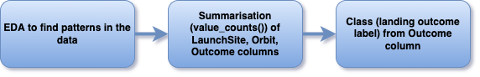
Data Wrangling
Some Exploratory Data Analysis (EDA) is performed to determine the label for training supervised models
The number and occurrences of launches on each site, each orbit and mission outcome per orbit type were calculated
A landing outcome label, Class, with 1’s and 0’s from Outcome column was create where;
‘1’ is the good outcome, i.e., the booster did land
‘0’ is the bad outcome, i.e., the booster did not land
Source Code:
https://github.com/khhaledahmaad/IBM-Data-Science-Professional-Certificate/blob/14bd495b945037a64f8381ac41d98005c7696b01/Applied Data Science Capstone/week1/Data Wrangling/labs-jupyter-spacex-Data wrangling.ipynb

Slide 11
EDA with Data Visualization
To perform EDA, scatter plots and a bar chart and a line graph were plotted to find the correlation between pair of features
The following graphs were added:
Flight Number vs. Launch Site scatter plot
Payload vs. Launch Site scatter plot
Success rate (mean of ‘Class’) vs. Orbit type bar chart
Flight Number vs. Orbit type scatter plot
Payload vs. Orbit type scatter plot
Date (Year) vs. Success (Class) line graph
Source Code:
https://github.com/khhaledahmaad/IBM-Data-Science-Professional-Certificate/blob/14bd495b945037a64f8381ac41d98005c7696b01/Applied Data Science Capstone/week2/Exploratory Analysis Using Pandas and Matplotlib/jupyter-labs-eda-dataviz.ipynb
Add the GitHub URL of your completed EDA with data visualization notebook, as an external reference and peer-review purpose

Slide 12
EDA with SQL
The SQL queries performed:
Display the names of the unique launch sites in the space mission
Display 5 records where launch sites begin with the string 'CCA'
Display the total payload mass carried by boosters launched by NASA (CRS)
Display average payload mass carried by booster version F9 v1.1
List the date when the first successful landing outcome in ground pad was achieved
List the names of the boosters which have success in drone ship and have payload mass greater than 4000 but less than 6000
List the total number of successful and failure mission outcomes
List the names of the booster_versions which have carried the maximum payload mass, using a subquery
List the failed landing_outcomes in drone ship, their booster versions, and launch site names for in year 2015
Rank the count of landing outcomes (such as Failure (drone ship) or Success (ground pad)) between the date 2010-06-04 and 2017-03-20, in descending order
Source Code:
https://github.com/khhaledahmaad/IBM-Data-Science-Professional-Certificate/blob/14bd495b945037a64f8381ac41d98005c7696b01/Applied Data Science Capstone/week2/Exploratory Analysis Using SQL/jupyter-labs-eda-sql-coursera.ipynb

Slide 13
Build an Interactive Map with Folium
Markers, circles, lines, and marker clusters were added to the folium map
Markers indicate text label around a specific coordinate
Circle indicate highlighted areas around a specific coordinate, like NASA Johnson Space
Lines are used indicate distance between two coordinates
Marker Clusters are used as a good way to simply a map containing many markers
Source Code:
https://github.com/khhaledahmaad/IBM-Data-Science-Professional-Certificate/blob/14bd495b945037a64f8381ac41d98005c7696b01/Applied Data Science Capstone/week3/Interactive Visual Analytics and Dashboard/lab_jupyter_launch_site_location.ipynb

Slide 14
Build a Dashboard with Plotly Dash
The following plots/graphs and interactions were added to the dashboard:
Launch Site Drop-down Input Component
Range Slider to Select Payload
Launch site vs. Success rate pie chart based on selected site dropdown
Payload vs. Success scatter plot based on selected payload range
The dropdown selection was useful to select a specific site to visualize the success rate for only that specific site
The range slider was useful to get scatter plot for payload vs. success for a specific range of payload
Source Code:
https://github.com/khhaledahmaad/IBM-Data-Science-Professional-Certificate/blob/14bd495b945037a64f8381ac41d98005c7696b01/Applied Data Science Capstone/week3/Interactive Visual Analytics and Dashboard/spacex_dash_app.py

Slide 15
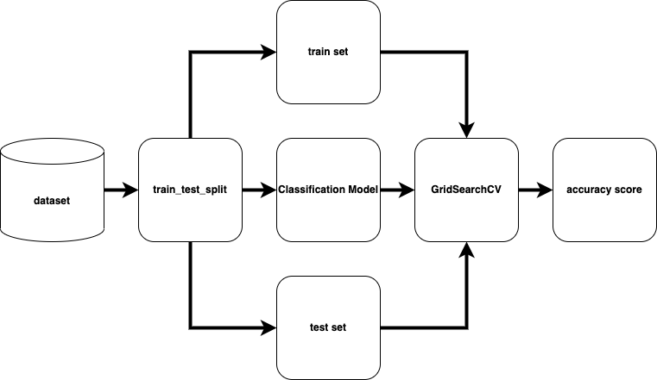
Predictive Analysis (Classification)
The dataset was split into train and test sets using train_test_split
Four Classification models were built; ‘Logistic Regression’, ‘Support Vector Machine’, ‘Decision Tree’, and ‘K-nearest Neighbours’
For each model, to find the best hyperparameters and best accuracy score, ‘GridSearchCV’ was used and fitted with the train set
‘GridSearchCV’ object for each model was tested against the test set and accuracy score was calculated
Source Code:
https://github.com/khhaledahmaad/IBM-Data-Science-Professional-Certificate/blob/14bd495b945037a64f8381ac41d98005c7696b01/Applied Data Science Capstone/week4/Predictive Analysis (Classification)/SpaceX_Machine Learning Prediction_Part_5.ipynb

Slide 16
Results
Exploratory data analysis results:
SpaceX uses 4 launch sites
There is no successful landing from 2010 till 2013
With increase in the flight numbers the success rate also increased
After ‘2013’ till ‘2020’, the success rate showed a significant increasing trend
The average payload mass carried by booster version ‘F9 v1.1’ is ‘2928 kg’
The first successful landing outcome in ground pad was achieved in ‘2015-12-22’
Only 4 boosters have success in drone ship and with payload between ‘4000 kg’ to ‘6000 kg’
Almost 100% (99/101) mission outcome was successful
’12’ ‘F9’ booster versions have carried the maximum payload mass
‘2’ ‘F9’ booster versions, have failed landing outcome in drone ship in year 2015
Between '2010-06-04' and '2017-03-20’ the most popular landing outcome is ‘No attempt’

Slide 17
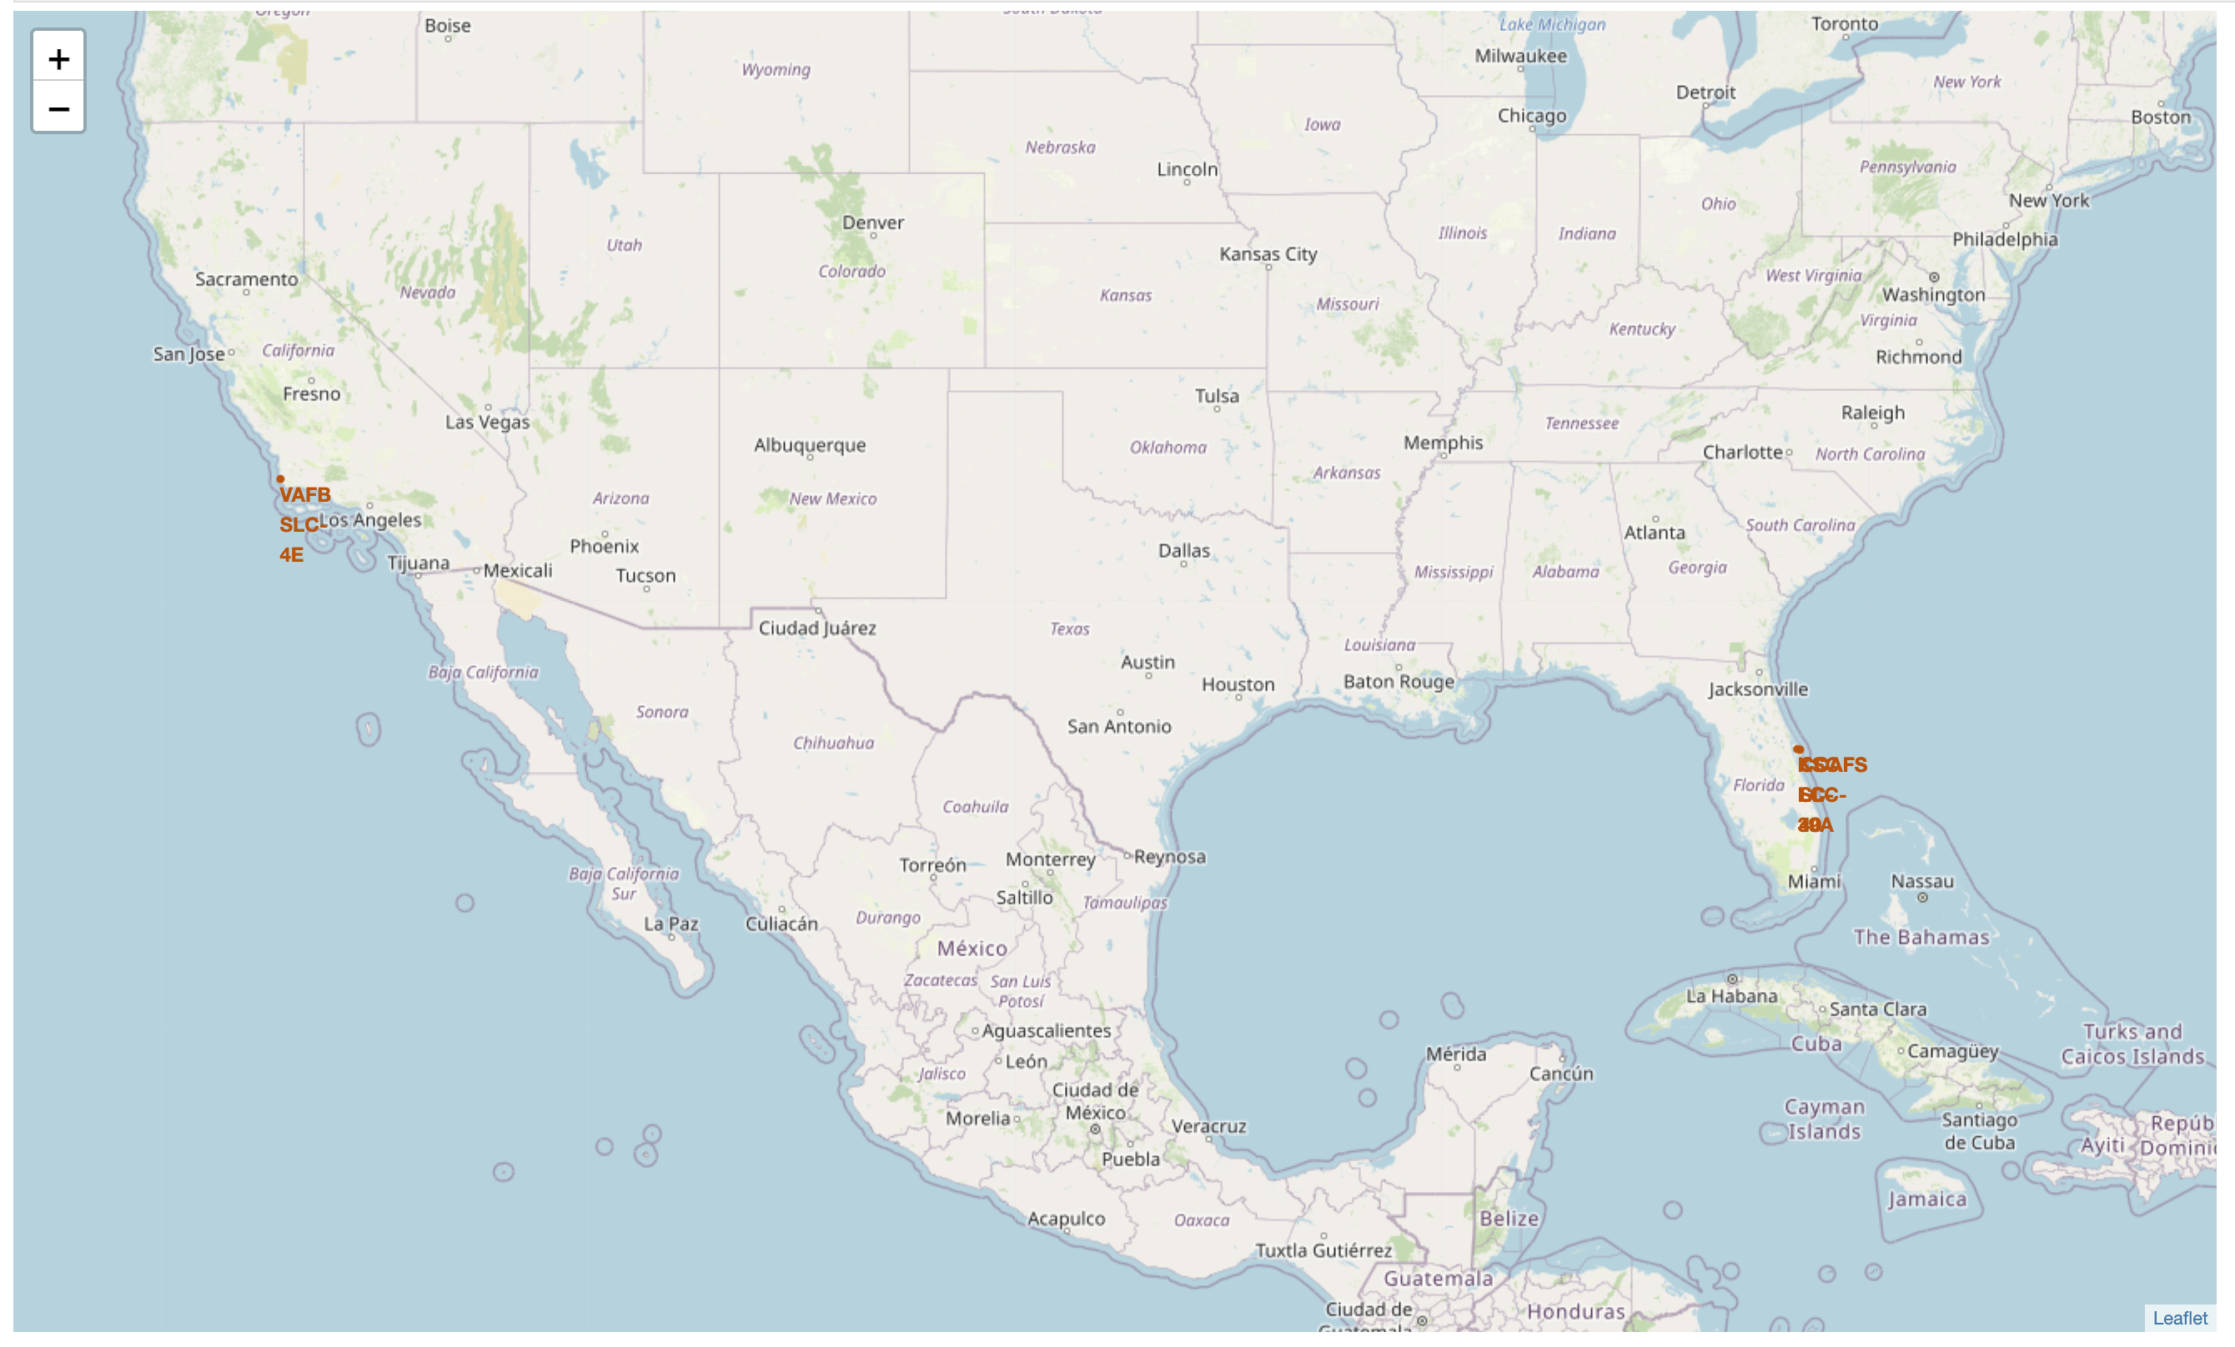
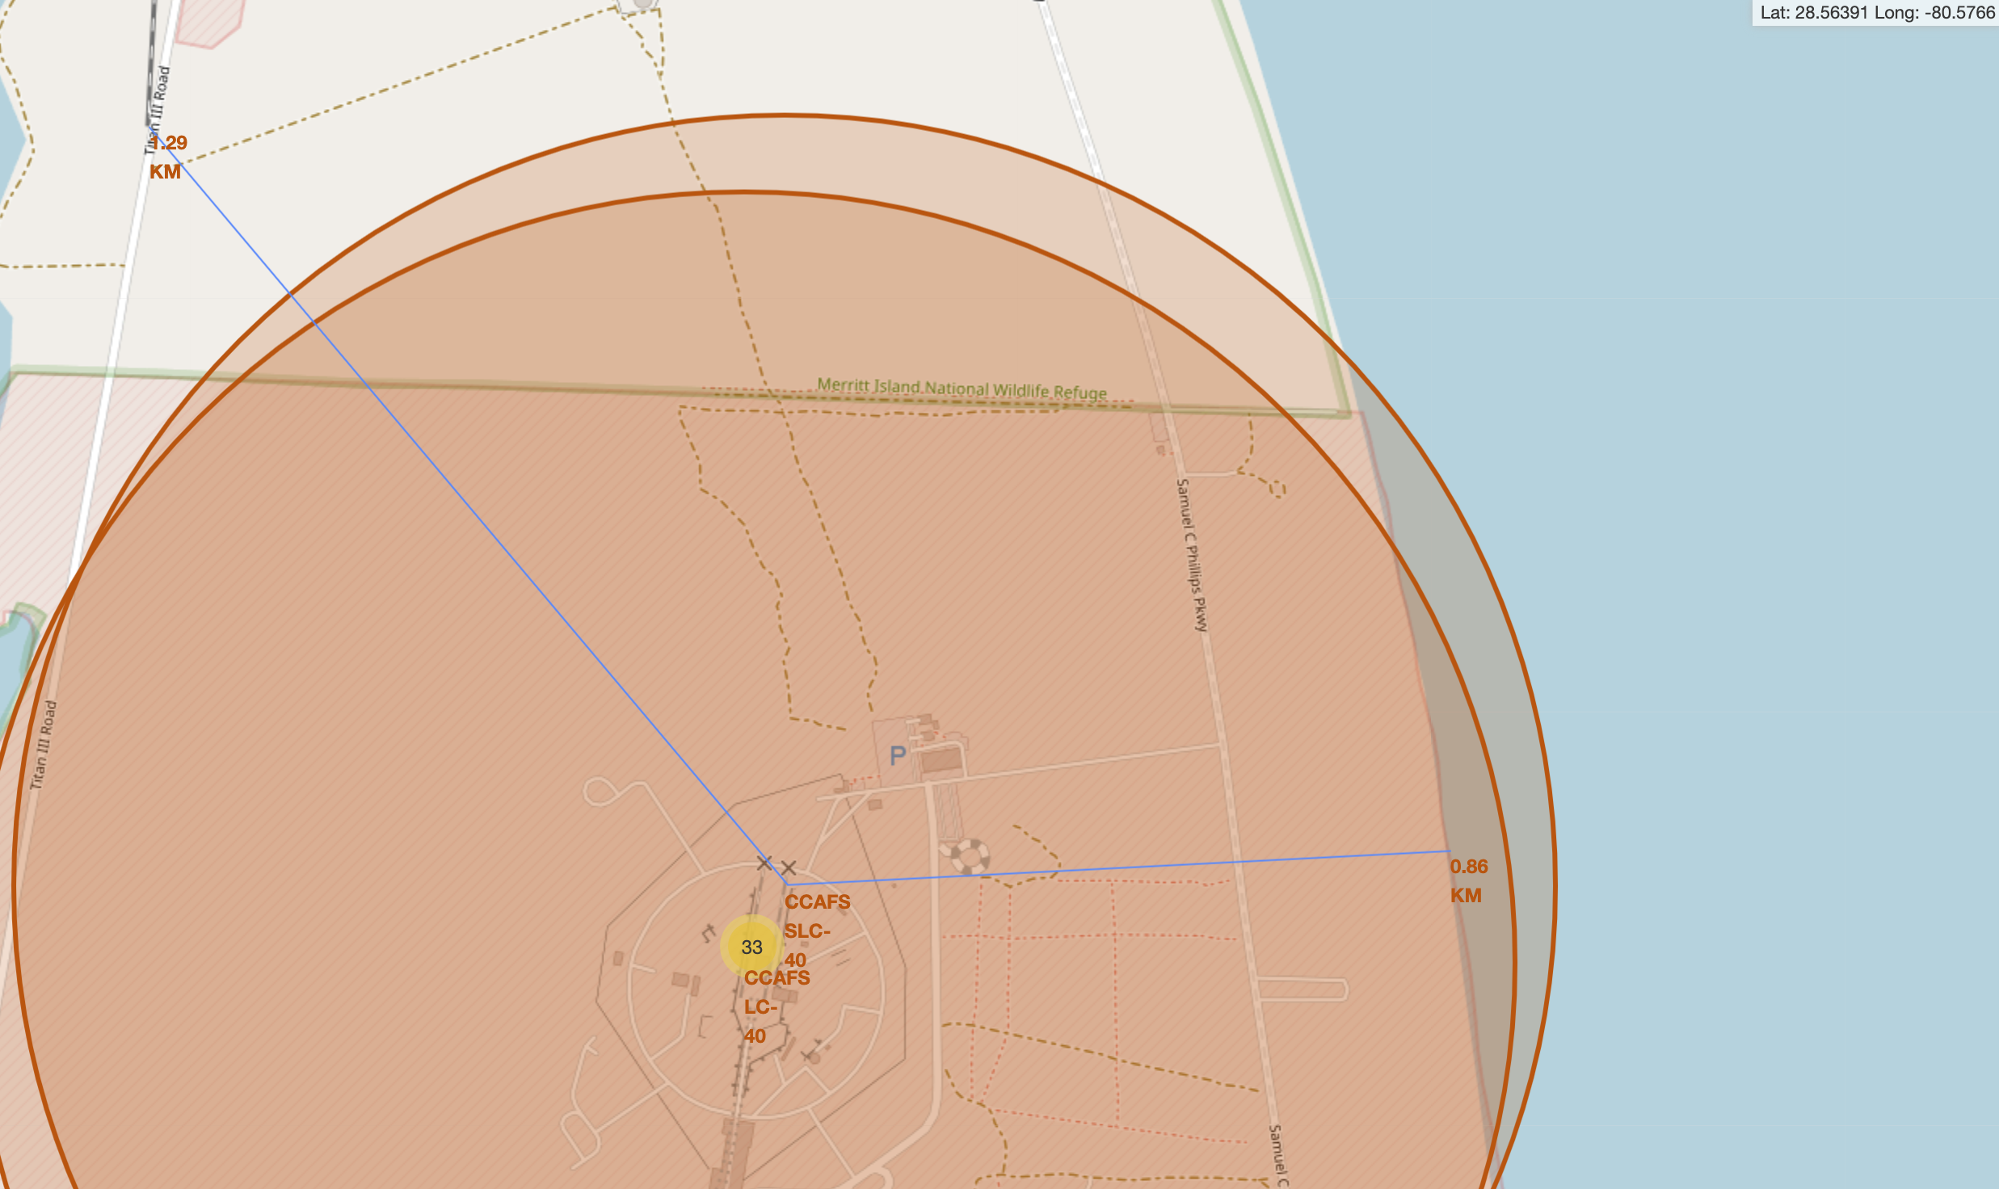
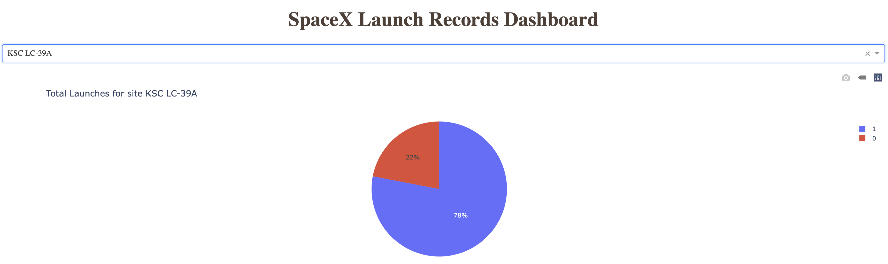
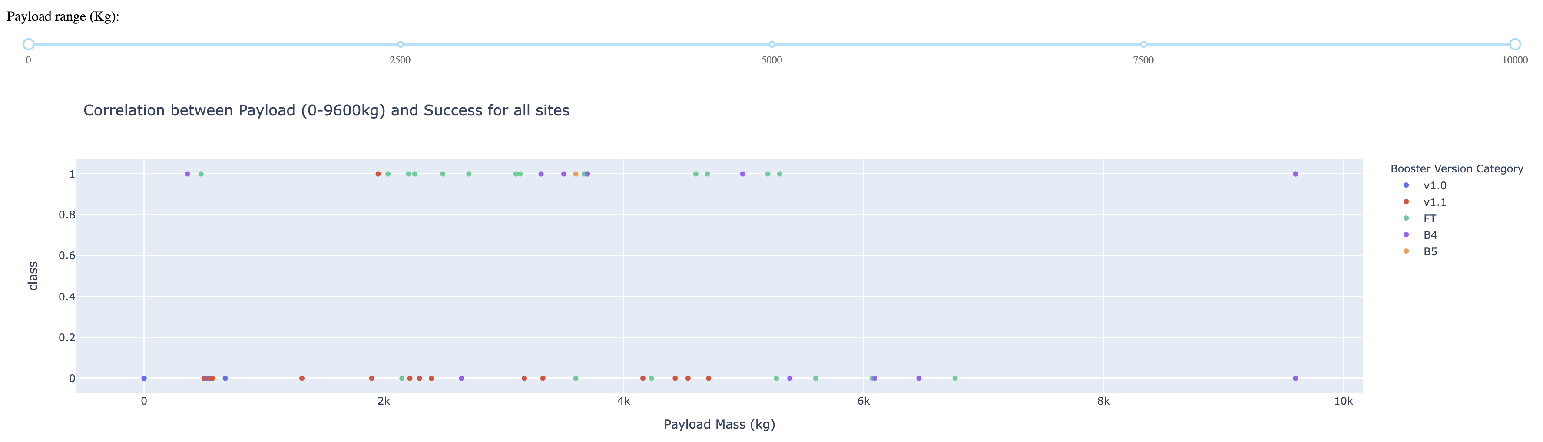
Results
Interactive analytics demo in screenshots:
All the launch sites are near cost lines, perhaps for safety and to prevent accidents also their proximities to roads and railroads have made them easily accessible incase of hazards
The interactive dashboard can filter success rate by launch site and payload range for quick and effective analysis

Slide 18
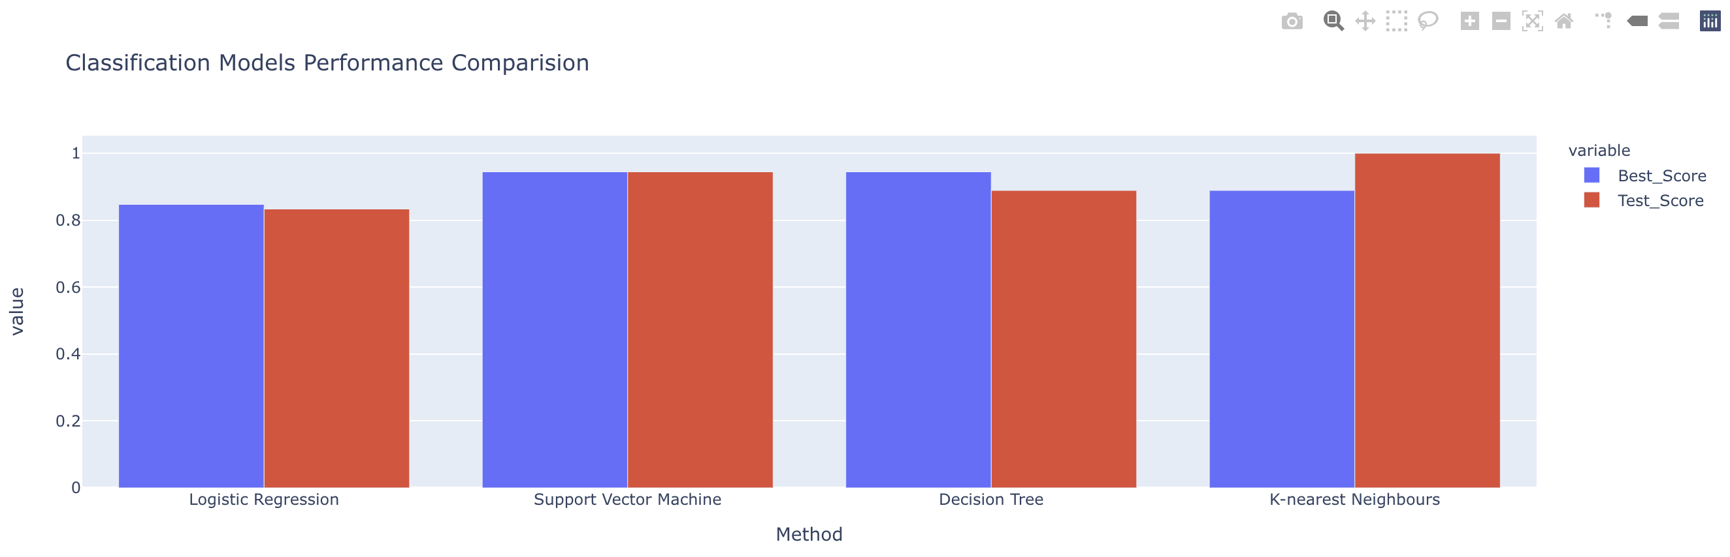
Results
Predictive analysis results:
All the Classification models are can predict the landing outcome more than 80% precisely
The best accuracy score, which is around 94%, is achieved for the ‘Support Vector Machine’ and the ‘Decision Tree’ classifier models
The highest accuracy score against the test dataset is achieved by ‘K-nearest Neighbours’ classifier model, which is 100%, meaning the model was able to predict the landing outcome for the test dataset 100% precisely, despite having one of the lowest best accuracy scores among the models

Slide 19

Section 2

Slide 20
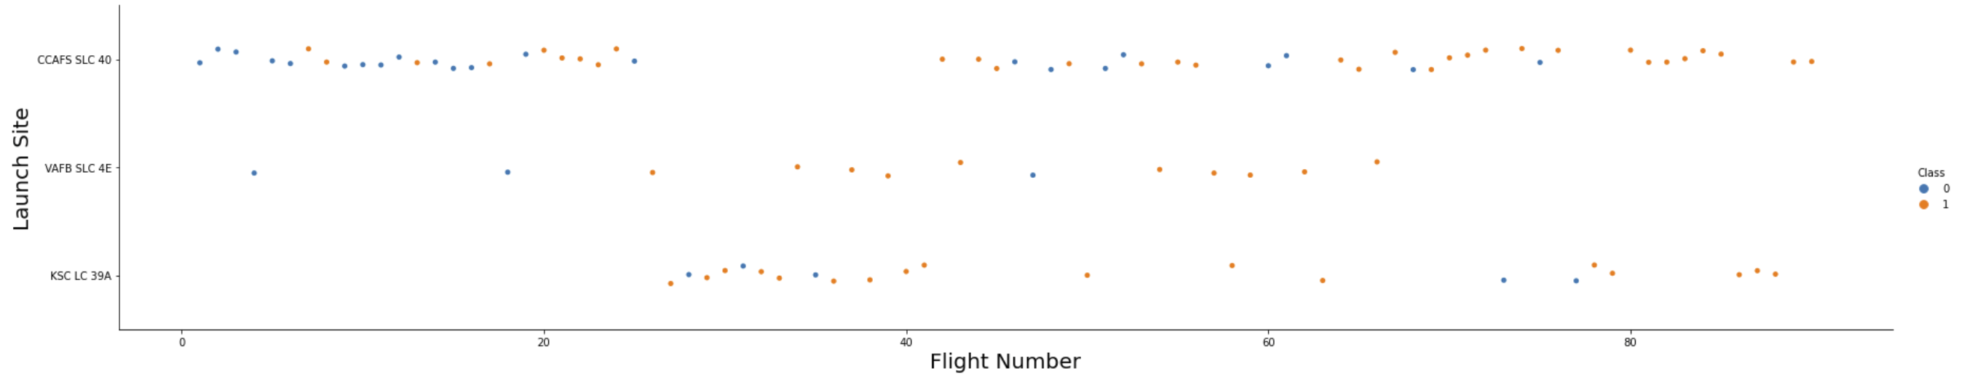
Flight Number vs. Launch Site
It is apparent that with increase in the flight numbers the success rate also increased
There is not any success for ‘VAFB SLC 4E’ and ‘KSC LC 39A’ sites for the first 20 flights
There is not any failure for ‘CCAFS SLC 40’ and ‘KSC LC 39A’ sites after 80 flights

Slide 21
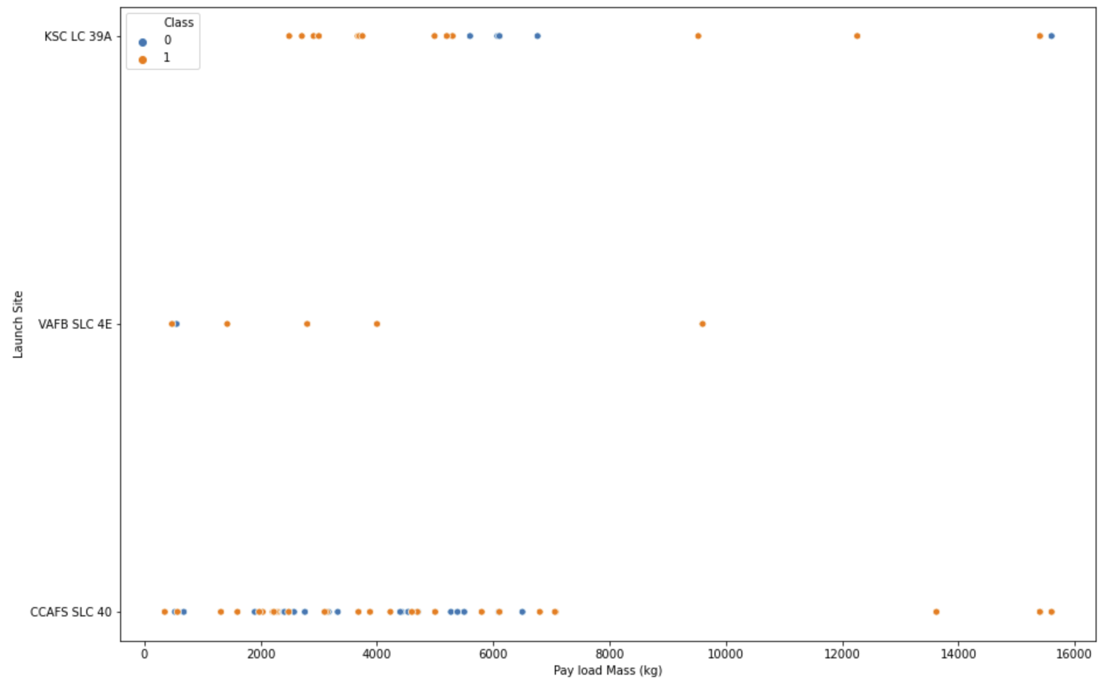
Payload vs. Launch Site
The ‘CCAFS SLC 40’ site is the most successful for payload over 8,000 kg
There is not any launches for ‘VAFB SLC 4E’ site for payload over 10,000 kg

Slide 22
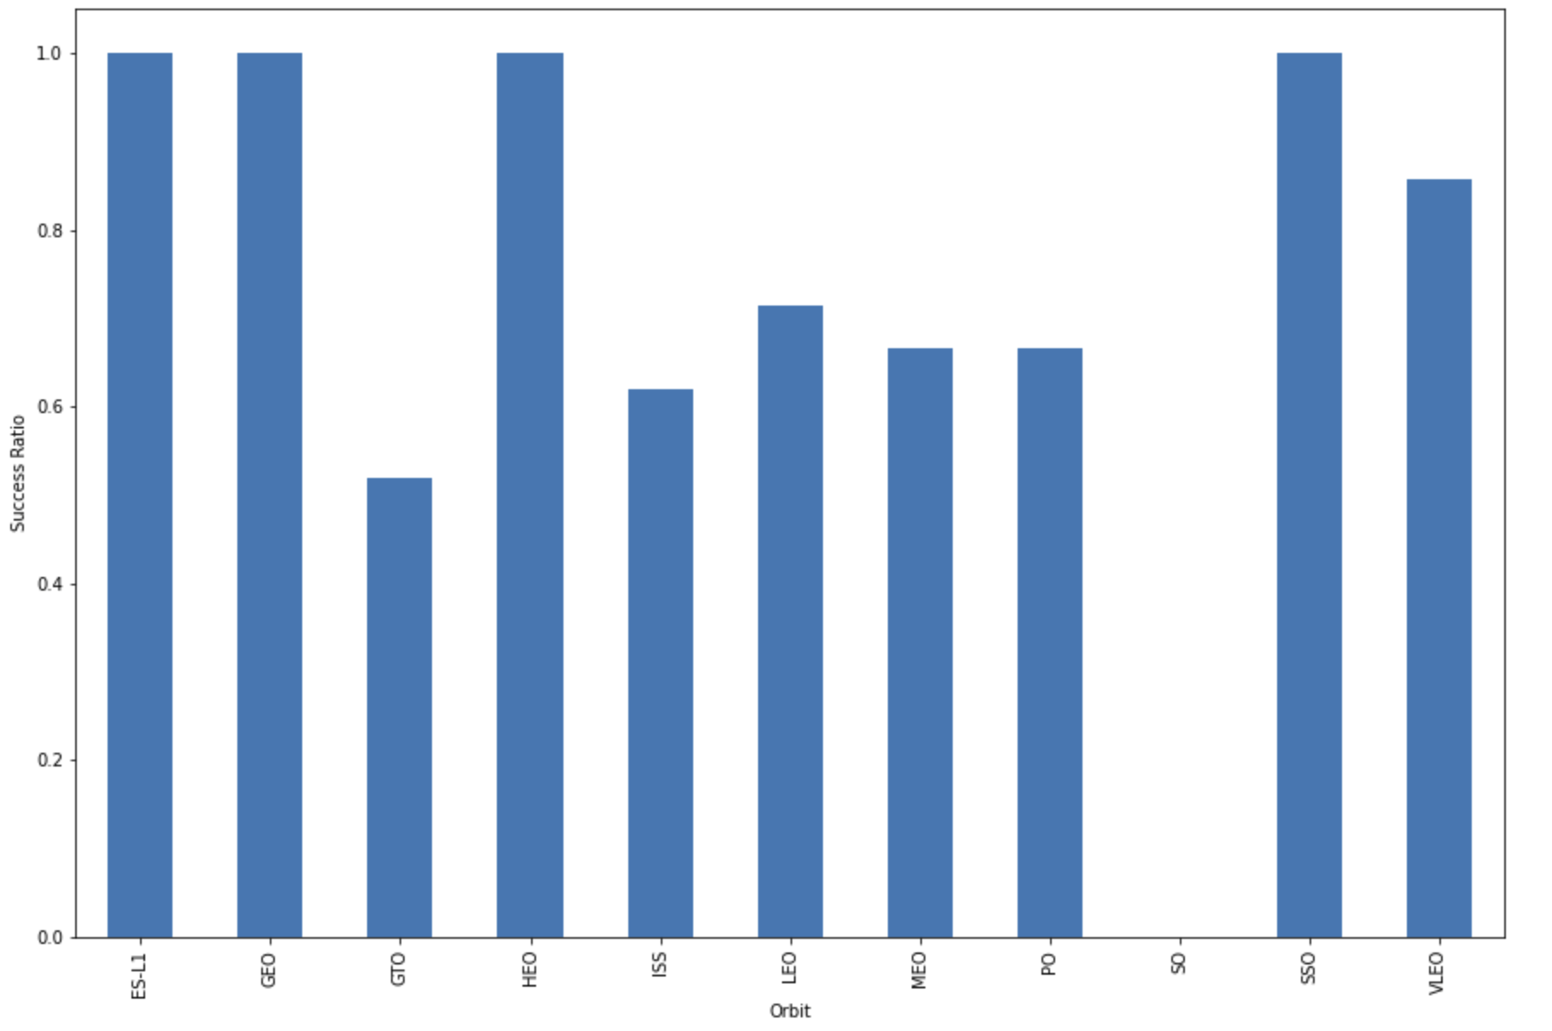
Success Rate vs. Orbit Type
The highest success rate (100%) is in the ‘ES-L1’, ‘GEO’, ‘HEO’ and ‘SSO’ orbits
The lowest success rate (0%) is in the ‘SO’ orbit

Slide 23
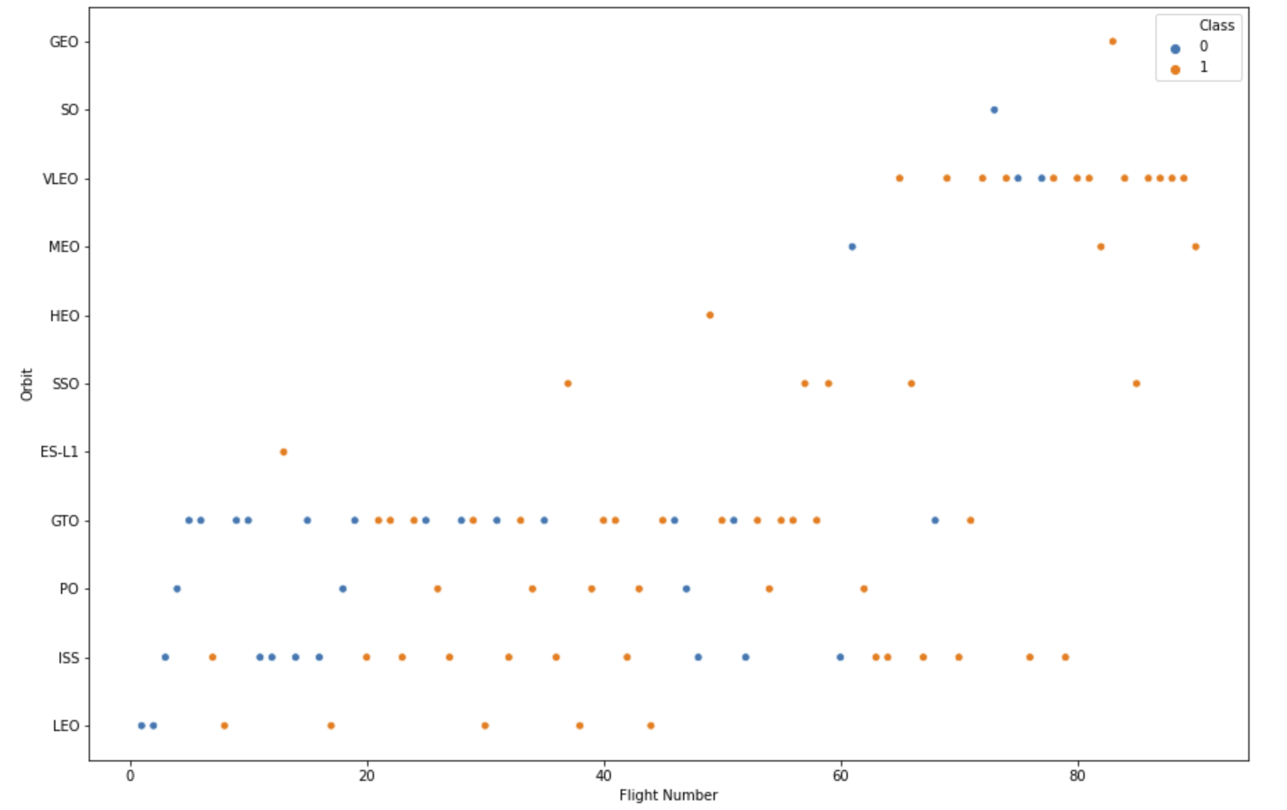
Flight Number vs. Orbit Type
In the ‘LEO’ orbit the Success appears related to the number of flights
There seems to be no relationship between flight numbers and orbit when in ‘GTO’ orbit

Slide 24
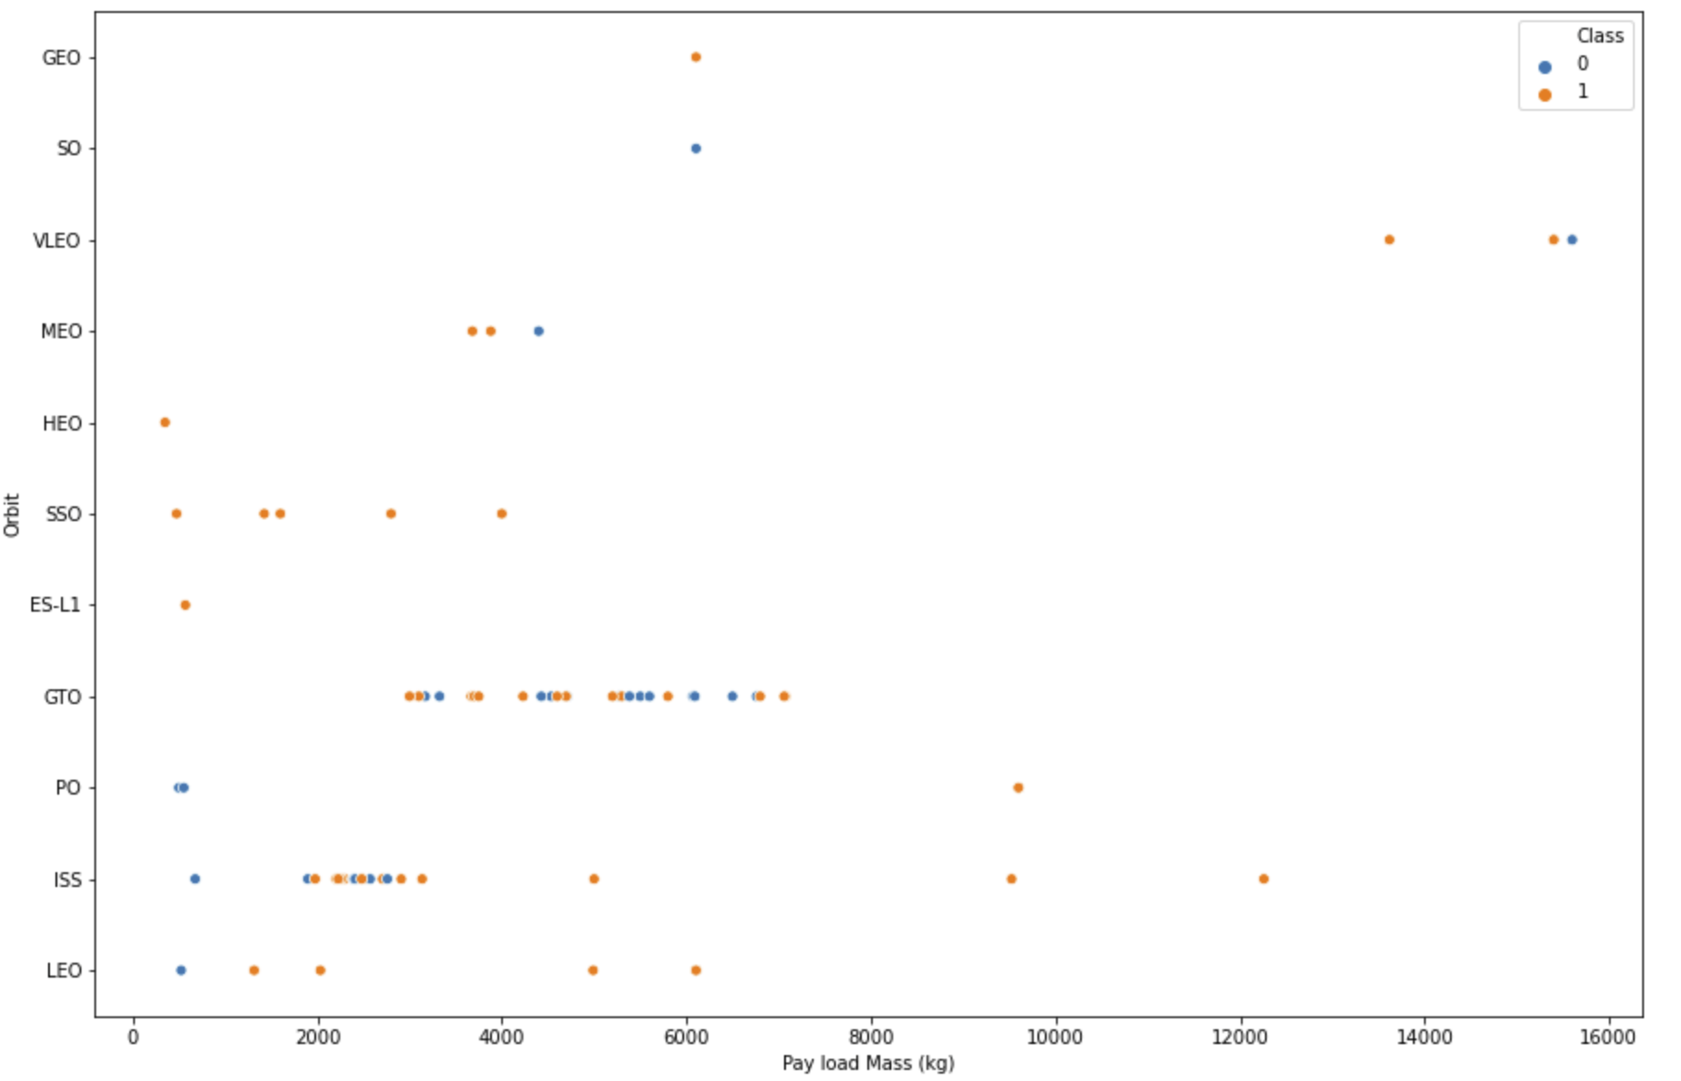
Payload vs. Orbit Type
‘LEO’ and ‘ISS’ have the most successful landings for payload over 4,000 kg
Landing outcome in the ‘GTO’ orbit does not seem to correlate to payload

Slide 25
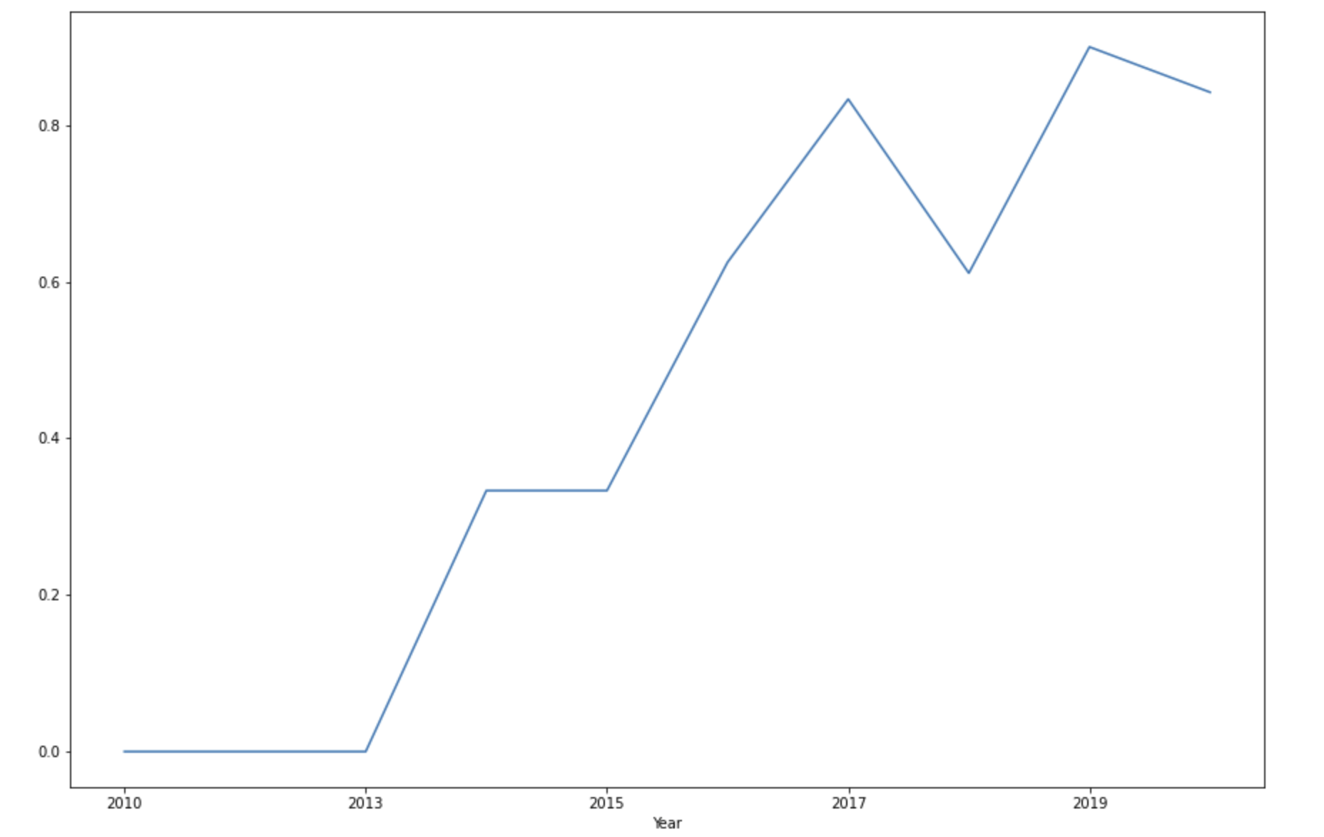
Launch Success Yearly Trend
There is not any successful landings from ‘2010’ to ‘2013’
After ‘2013’ till ‘2020’, the success rate showed a significant increasing trend

Slide 26
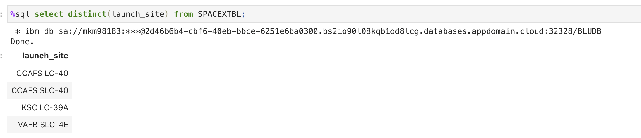
All Launch Site Names
There seems to be only four unique launch sites for SpaceX
The unique launch sites can be obtained with ‘DISTICT’ keyword or ‘UNIQUE( )’
function in the ’SELECT” query followed by the ‘launch_site’ attribute in the dataset

Slide 27
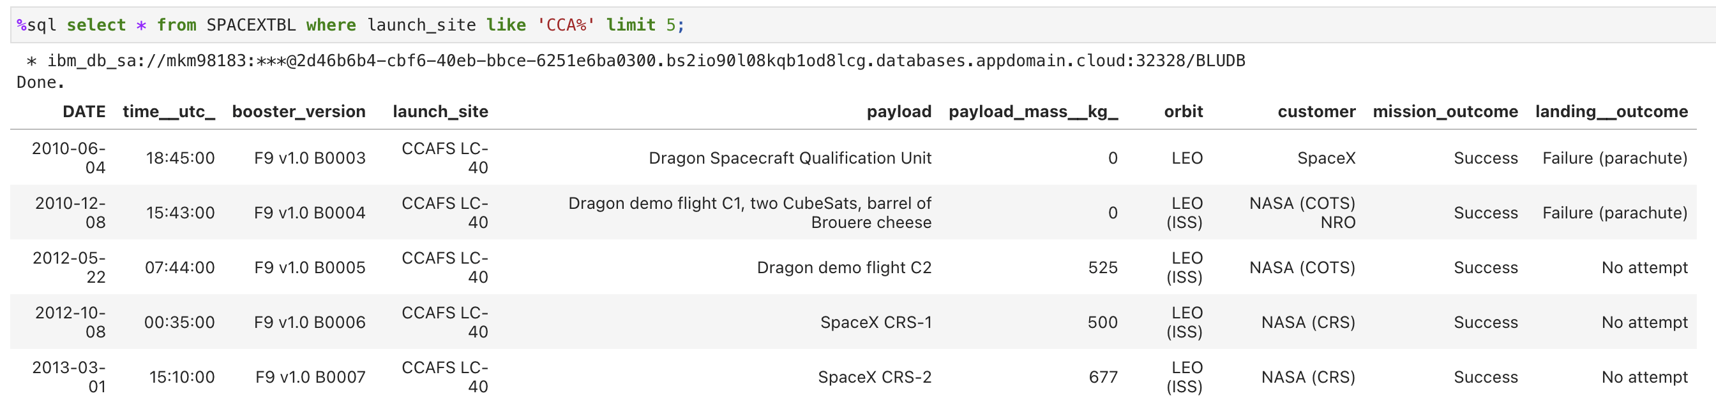
Launch Site Names Begin with 'CCA'
5 records where launch sites begin with `CCA`:
The outcome is achieved using SQL logical operator ‘LIKE’ and keyword ‘LIMIT’

Slide 28
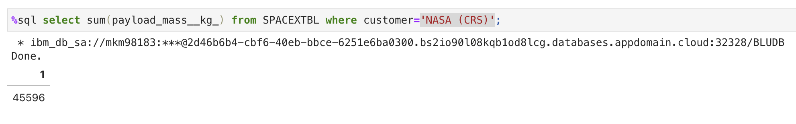
Total Payload Mass
The total payload carried by boosters from NASA:
The outcome is achieved using SQL ‘SUM( )’ function for the ‘payload_mass__kg_’ attribute and a ‘WHERE’ clause for ‘customer’ attribute which is equal to (=) ‘NASA (CRS)’

Slide 29
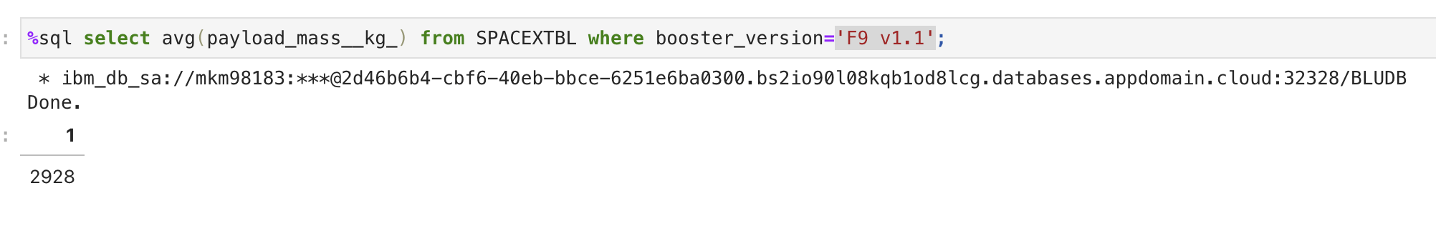
Average Payload Mass by F9 v1.1
The average payload mass carried by booster version F9 v1.1:
The outcome is achieved using SQL ‘AVG( )’ function for the ‘payload_mass__kg_’ attribute and a ‘WHERE’ clause for ‘booster_version’ attribute which is equal to (=) ‘F9 v1.1’

Slide 30
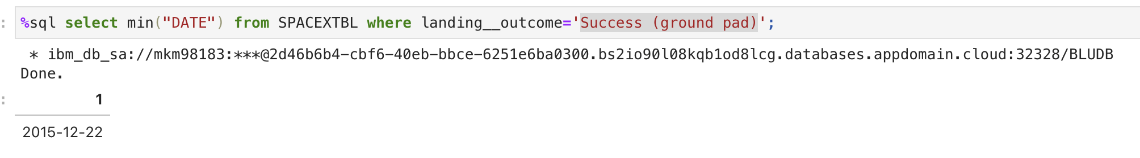
First Successful Ground Landing Date
The dates of the first successful landing outcome on ground pad:
The outcome is achieved using SQL ‘MIN( )’ function for the ‘DATE’ attribute and a ‘WHERE’ clause for ‘landing__outcome’ attribute which is equal to (=) ‘Success (ground pad)’

Slide 31
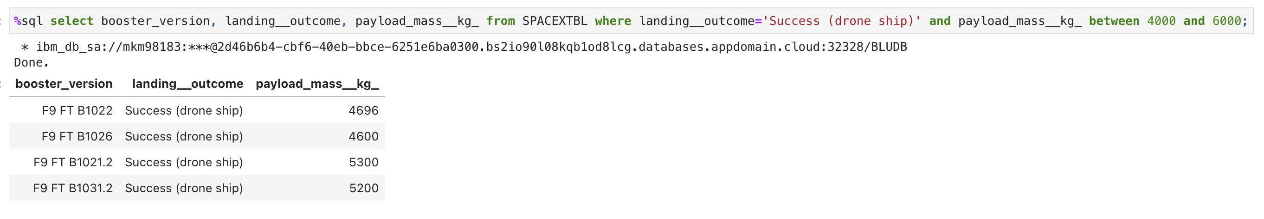
Successful Drone Ship Landing with Payload between 4000 and 6000
The names of boosters which have successfully landed on drone ship and had payload mass greater than 4000 but less than 6000:
The outcome is achieved using a SQL ‘WHERE’ clause for ‘landing__outcome’ attribute which is equal to (=) ‘Success (drone ship)’ and ‘payload_mass__kg_’ attribute with ‘BERWEEN’ keyword to range between ‘4000’ to ‘6000’ values only

Slide 32
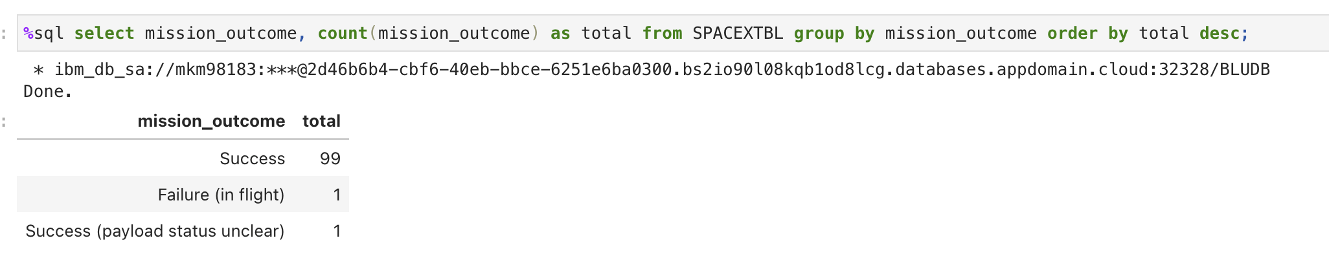
Total Number of Successful and Failure Mission Outcomes
The total number of successful and failure mission outcomes:
The outcome is achieved using SQL ‘COUNT( )’ function for the ‘mission_outcome’ attribute and a ‘GROUP BY’ clause for ‘mission_outcome’ attribute, where the count as shown as alias ‘total’ and the result is ordered by ‘total’ using the ‘ORDER BY’ keyword

Slide 33
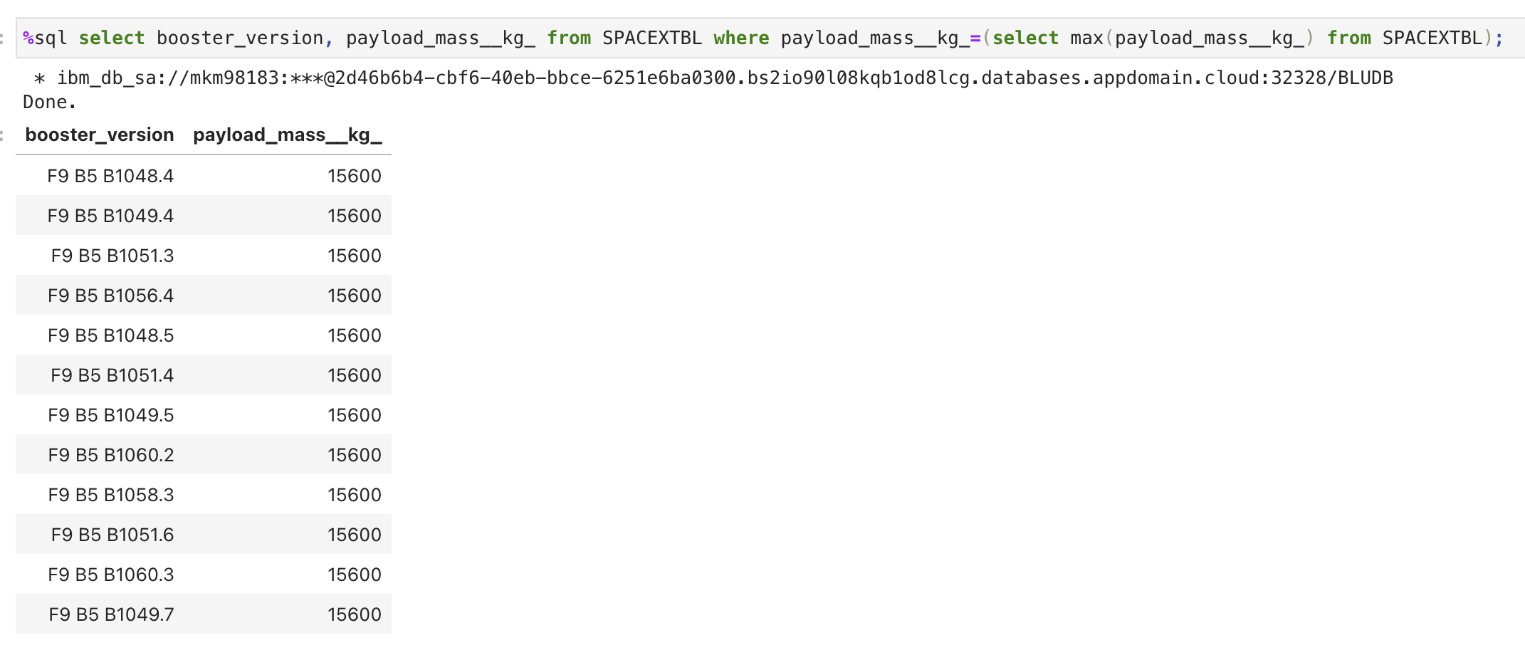
Boosters Carried Maximum Payload
The names of the booster which have carried the maximum payload mass:
The outcome is achieved using a SQL ‘WHERE’ clause for ‘payload_mass__kg_’ attribute which is equal to (=) the value from the subquery which uses the ‘MAX( )’ function for the ‘payload_mass__kg_’ attribute

Slide 34
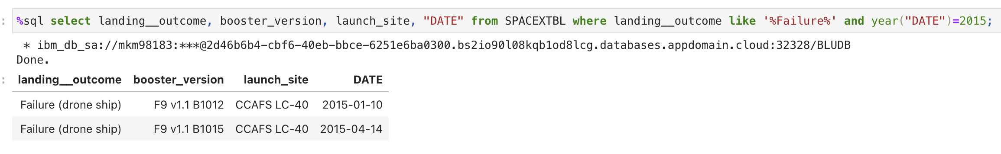
2015 Launch Records
The failed landing_outcomes in drone ship, their booster versions, and launch site names for in year 2015:
The outcome is achieved using a SQL ‘WHERE’ clause for ‘landing__outcome’ attribute with ‘LIKE’ logical operator for only ‘Failure’ and ‘YEAR’ function was used for ‘DATE’ attribute which is equal to (=) ‘2015’

Slide 35
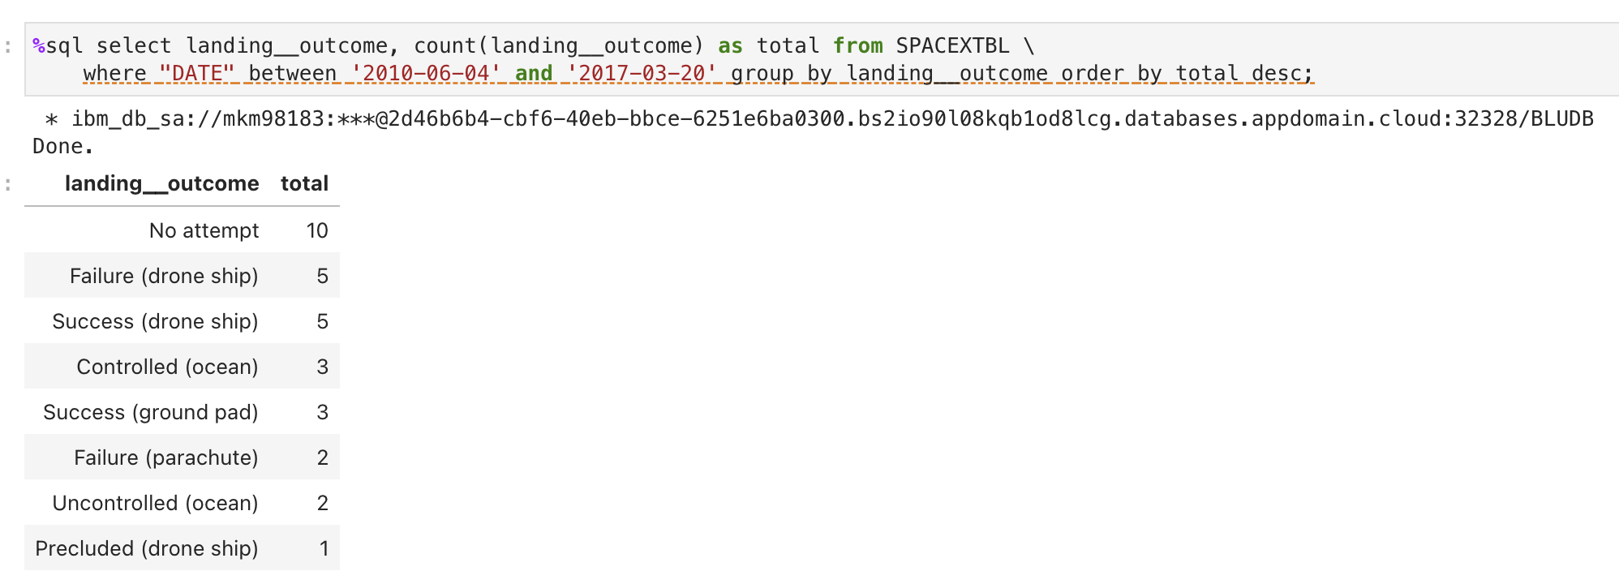
Rank Landing Outcomes Between 2010-06-04 and 2017-03-20
Ranking of the count of landing outcomes (such as Failure (drone ship) or Success (ground pad)) between the date 2010-06-04 and 2017-03-20, in descending order:
The outcome is achieved using SQL ‘COUNT( )’ function for the ‘landing__outcome’ attribute with a ‘WHERE’ clause with ‘BETWEEN’ keyword for ‘DATE’ attribute for date between the expected range and a ‘GROUP BY’ clause for ‘landing__outcome’ attribute, where the count as shown as alias ‘total’ and the result is ordered by ‘total’ using the ‘ORDER BY’ keyword in the descending order using ‘DESC’ keyword

Slide 36

Section 3

Slide 37
Launch Sites Location
All the launch sites are near cost lines, perhaps for safety and to prevent accidents
The launch sites are also not very far from the roads and railroads

Slide 38
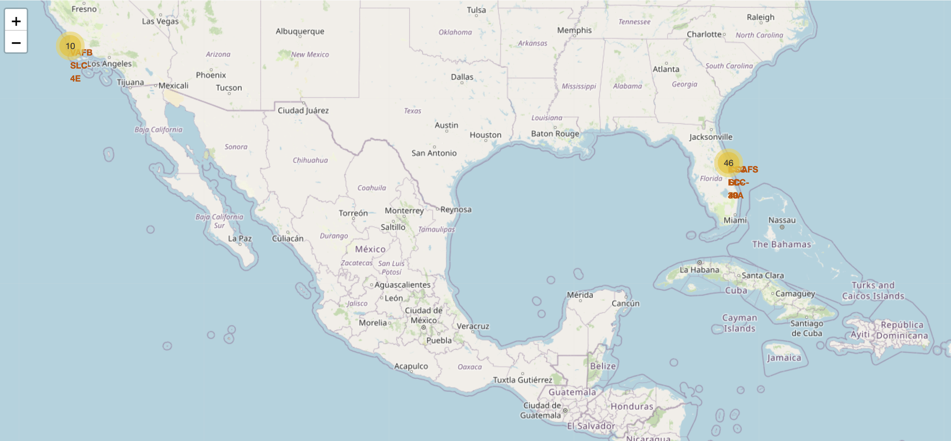
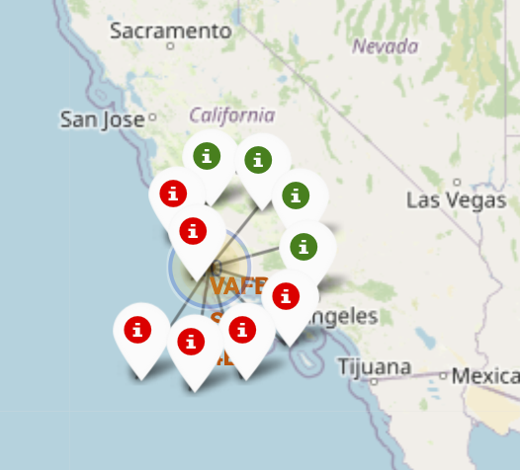
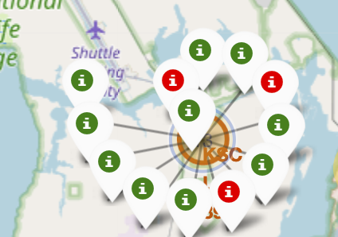
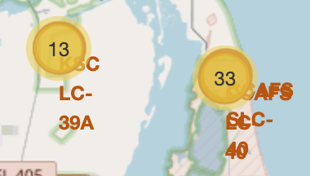
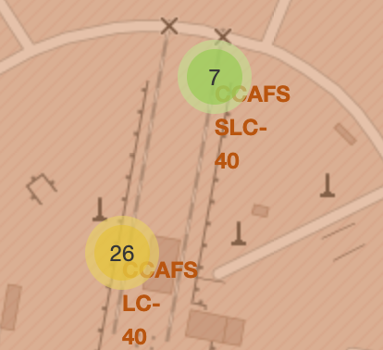
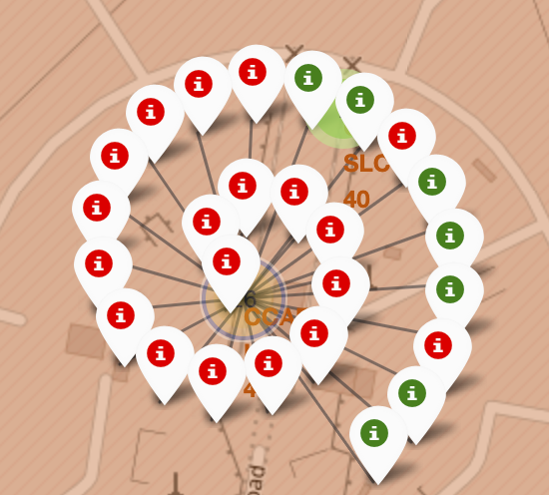
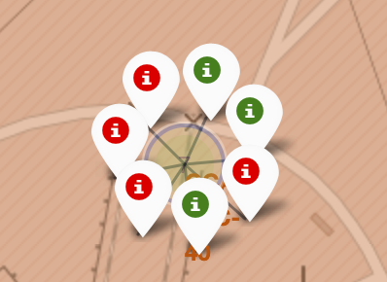
Launch Sites with Coloured Markers for Success and Failure
The green markers indicate success and red markers indicates failure for a particular site
Most number of lunches (26), success and failure combined, were launched from ‘CCAFS SLC-40’ site

Slide 39
CCAFS SLC-40 Proximities to Railroad and Coastline
Proximities of launch sites to infrastructure and transport is important in case of crash landing
‘CCAFS SLC-40’ site is only 0.86 km far away from cost line and 1.29 km from the nearest railroad, but far away from inhabited areas, therefore, not hazardous

Slide 40

Section 4

Slide 41
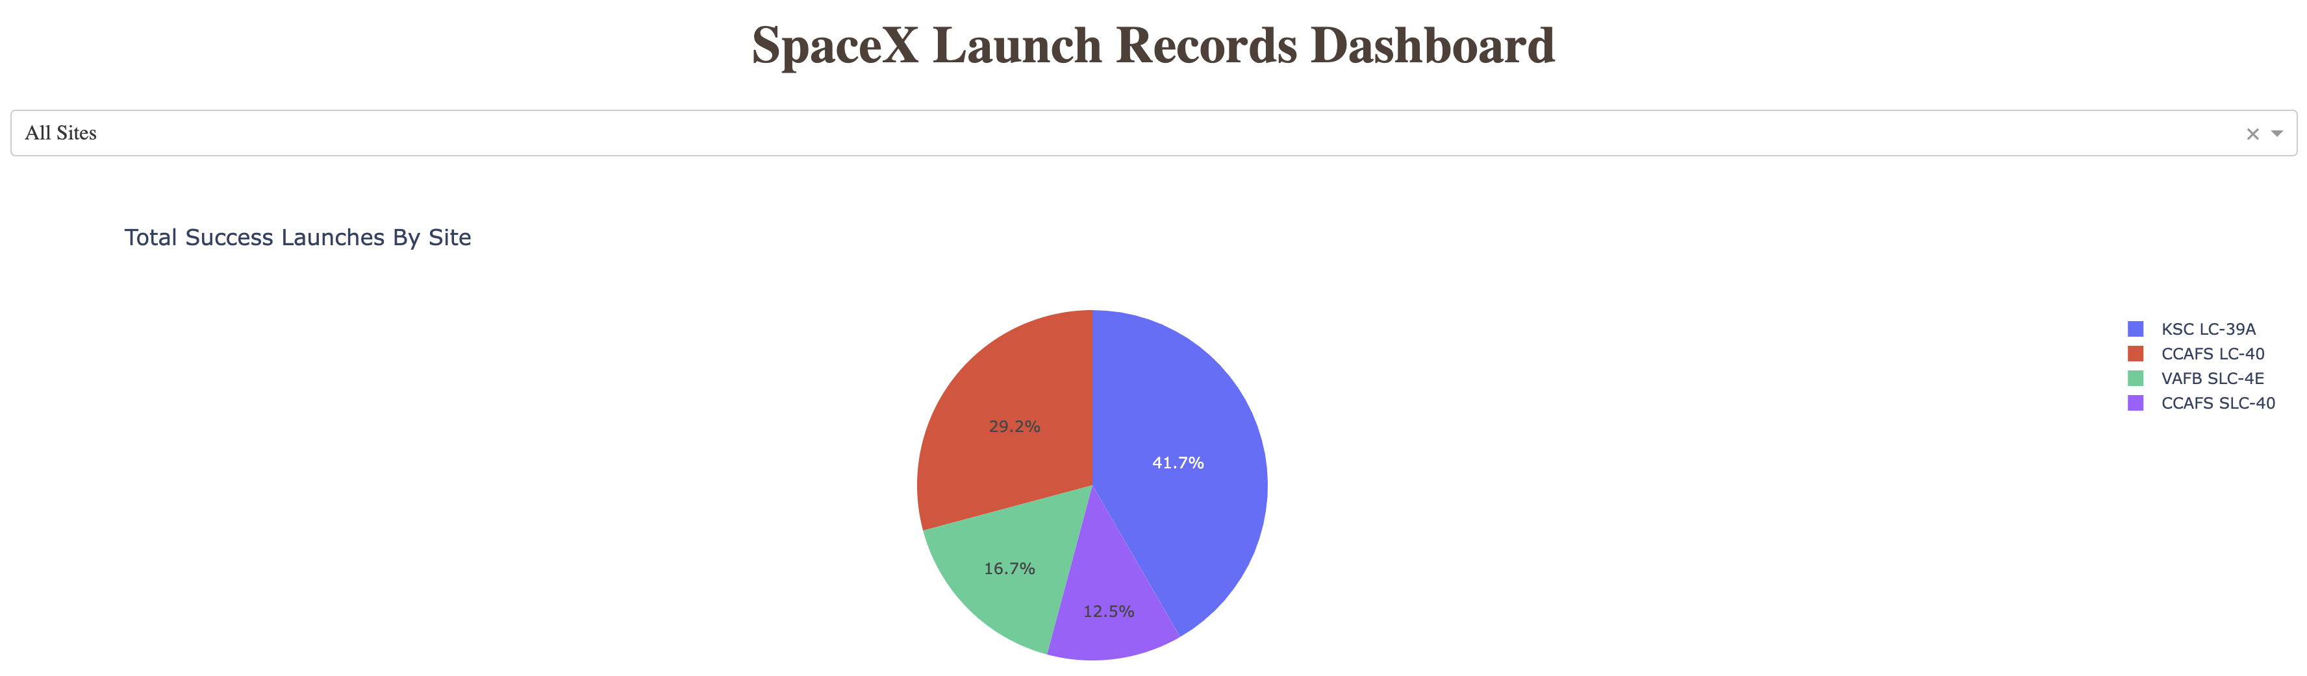
SpaceX Successful Launches by Sites
Success rate of the sites is a very important factor to choose the right site for a successful launch, for example, it is 41.7% more likely to launch successfully from the ‘KSC LC-39A’ site

Slide 42
Success Launch Rate for KSC LC-39A Site
78% launches were successful from this site
It is likely to choose this site as the most reliable for successful launches

Slide 43
Payload vs. Launch Outcome by Booster Version for all Sites
Booster version ‘B4’ is the most successful for payload over 8,000 kg
Booster version ‘FT’ has the most successful rate for payload ranging from 2,000 to 4,000 kg

Slide 44

Section 5

Slide 45
Classification Accuracy
4 Classification models were built and their best accuracy and the accuracy against the test dataset were plotted in a bar chart
The ‘Support Vector Machine’ and the ‘Decision Tree’ models have the highest accuracy of 94%, where the highest accuracy (100%) against the test dataset is achieved by the ‘K-nearest Neighbours’

Slide 46
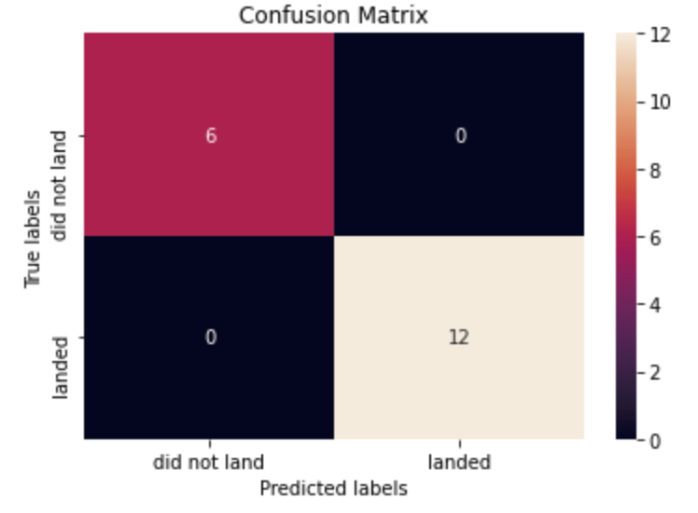
Confusion Matrix
The confusion matrix of the best performing model against the test dataset
The confusion matrix for ‘K-nearest Neighbours’ shows that ‘0’ False Positive and ‘0’ False Negative were predicted by that model against the test dataset
Thus, this model was 100% successful to predict success and failure against the test dataset

Slide 47
Conclusions
Different data collection sources were utilized to fulfil data requirements
Data Wrangling helped prepare the data for supervised learning at the later stage
EDA helped understand the data and the stories and patterns in them through queries and visualization
The interactive analytics helped find proximities of sites and analyze success rate for launch sites and payload range through quick dropdown selection and payload ranging
The best launch site is ‘KSC LC-39A’
Although most of the mission was successful, the landing outcome trends to improve within time and increasing number of flights, and perhaps, improvement of technology

Slide 48
Appendix
GitHub Link to Project:
https://github.com/khhaledahmaad/IBM-Data-Science-Professional-Certificate.git
Tools used for flowcharts:
Diagram.net: https://www.diagrams.net/
Thanks, and accreditation:
IBM: https://www.ibm.com/
Coursera: https://www.coursera.org/

Slide 49


